Slide 1
Content Extract Overview
BY Atul Upadhyay

Slide 2
Content Extract Introduction
A service that extracts tax content from Determination to be used in a external system
Systems such as: ERP, Point of Sale, e-commerce, or other type of proprietary system where indirect tax calculation is required
Permits extraction of standard and custom tax content
Default extract file output format is JSON / XML
Extract can be built to target system import specifications

Slide 3

CE Introduction (Contd.)
MORE THAN A RATE
Tier structured rates, tax types, fees, receipt descriptions
SHIP-FROM-STORE
Select geographies to be included to support ship-from-store transactions
PRODUCTS
Extract includes only the product taxability rules applicable to your business
COMPANY SPECIFIC
Content relevant to your business using your existing tax policy configurations
DATA ACCESS
REST service provides direct access to export data quickly
CLOUD ENABLED
The extract is available as part of the ONESOURCE Platform

Slide 4

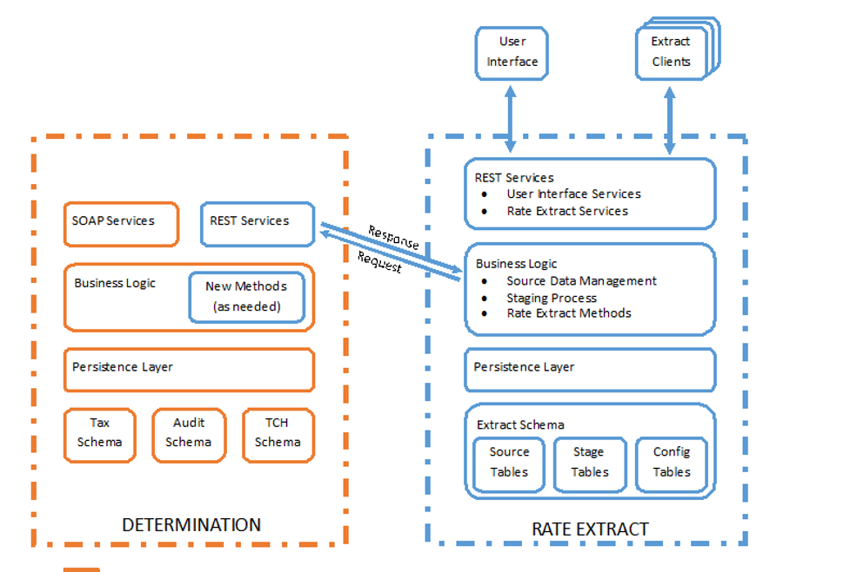



CE Architecture

Slide 5
CE Architecture Explained
REST Services (DETERMINATION) : These new private REST Services will be used to capture data from Determination. The Source Data Management process will invoke calls to these services to populate the Source Tables. The specific REST service definitions are defined below under REST Services (DETERMINATION). These additional methods will likely need to be developed in the Business Logic layer of DETERMINATION in order to accommodate the needs of the REST Services.
User Interface : The UI is leveraging new REST Services developed within the RATE EXTRACT environment. The purpose of the user interface is to allow the users the ability to create and maintain extract definitions according to the business needs of the individual client and their extract clients.
Extract Clients : These clients invoke calls to public REST Services to retrieve the extract data. The client formats the data according to its individual requirements. For example, a client for Oracle Retail XStore will generate files according to the DataLoader format definitions.
Business Logic (RATE EXTRACT) : The Business Logic layer contains all the components necessary to manage the source tables, maintain the stage tables, and user interface logic.
Persistence Layer :The persistence layer is a set of data objects that interact with Hibernate entity objects in the Extract Schema.
Extract Schema :The extract schema is comprised of these sets of tables…
Source Tables house all the source data from determination. Note that the data is independent of the extracts. For example, the locations table contains all locations – not just locations for a particular extract.
Stage Tables contain the data specific to the individual extracts. They are the cross-reference between the extract definitions and the source data.
Config Tables contain the extract definitions.

Slide 6
Content Extract UI Workflow
Content Extract Workflow
Go to Onesource Indirect Tax> tools> Content extract
Create extract
Configure an extract definition by giving
company name: which owns extract definition
extract name: this value must be unique for the company
extract begin date : Staging prepares and returns the rate and rules for extract begin date to infinity.
Select the Jurisdiction to extract i.e. countries and states for the extract.
Select the tax type and authorities for extract
Select the authorities exception for extract
Define rules for the extract like to group your data based on one of the following fields : Authority, Authority type and tax type, secondly including address attributes in the extract.

Slide 7
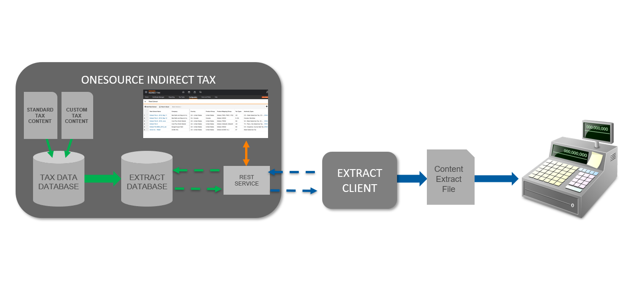
Content Extract Backend Workflow

Slide 8
CE Backend Workflow Explained
Aptos jar makes a rest web service call to your system and refactor/reformat the response which they get in JSON format into the rates files and feed it to POS terminals.
Content-extact.jar: Rest call will come to this server, then it authenticates the client and delivers the specific extract they have asked for.
Staging.jar: this is a spring boot application which runs every 2 hours, looks for change in tax content or customer definition , regenerates staged data specific to a customer and makes them available whenever they want to pull them from the client jar. It marries the determination source data with the user configuration data.
Source-data-management.jar: It periodically extract tax data and company configuration from the determination db, twice a day and takes an hour to run. This is also a spring boot application. It makes rest WS call to a dedicated determination node (give them all the jurisdiction, give me all the product types and company) and store the returned result into context extract source db.

Slide 9

Content Extract Services
Source Data Management (SDM) -It is a process to capture the data from the onesource systems. This process runs at least once per day. It captures the snapshot of data for all companies.
Content Staging - Staging will process the most current successful batch and remove the SDM data from all previous batches.
Executed approximately every two hours.
Staging processes each extract definition separately. With each execution, it first checks the previous successful execution for the extract. If the latest batch created by SDM is greater than the last batch processed it will process the extract. If not, the extract is ignored. Each time an extract is processed the Content Version is incremented.
This way, the system calling the Content Extract Service can know if it has a new version to process. Staging acts in the same way as Determination. However, instead of determining the tax for a particular transaction it determines the taxes for all the location and product combinations defined within the extract definition.
Staging creates a set of data comprised of locations, products, and their associated treatments. This enables the Extract Client to consume a relatively simple structure without having to perform the Determination logic
TAX TREATMENTS API- The Tax Treatments API is the service used by external systems to retrieve a complete or incremental content extract as configured by your extract definition in ONESOURCE Indirect Tax.
GET : /taxtreatments/company/{companyName}/extractName/{extractName}?loadMethod={loadMethod}

Slide 10
Extract Client
Small application installed on a customers desktop or server
Makes an authenticated call to the ONESOURCE Platform Content Extract REST Service using a batch file
Defines the parameters for the data the customer needs extracted
Content Extract Name
Specific URL (ONESOURCE URL)
Options such as Full/ChangesOnly
Generates the XML/JSON File from the Content Extract REST Service
Customer can extract the data into: memory, a file, or into a database
Data is structured based on definition of target system (Aptos, Oracle Xstore, etc.)

Slide 11
Need of Content Extract ?
With Content Extract, you can generate rate tables for use with systems that do not have a real-time integration with Indirect Tax or as a backup for situations where your system cannot reach your tax determination engine. Content Extract is especially useful for point‑of‑sale systems such as those used in retail and e-commerce
With ONESOURCE Content Extract, you can generate customized rate files for indirect taxes based on your company's tax policy. Get the exact tax rate and fee information you need, formatted and organized to your specifications, for use with retail point of sale systems, legacy systems that lack integration capability, cloud solutions that don't allow real-time integration, or any other system or routine requiring file-based tax rate information.

Slide 12

Scenarios where Content Extract is used ?
Any customer with a non-integrated system that requires tax rate data to be loaded into a system. Primarily this would be used by retail customers (POS system) and E-Commerce customers that need a rate table backup. Other examples include companies that use systems like Ariba OnDemand, Oracle Fusion, etc. which don’t have real-time integrations but do allow for rate table uploads.
Retail Point Of Sale (POS) systems is an example of where retail businesses want to perform the sales tax calculation using the POS system, and a rate extract file could also be used for e-commerce rate backup tables (in the event the tax engine is unreachable like Twitter), older systems unable to perform data integration (e.g. mainframe), or cloud solutions that don’t allow for real-time tax calculation integration.
To successfully serve the Retail vertical, Indirect Tax must provide real-time tax determination, and also be able to extract tax rate data to feed into a POS or ancillary systems that are unable to make real-time tax calls. Some POS solutions are able to make real-time tax calls but still require backup tax tables in the event there is a network disruption. When rate files are uploaded to a POS or offline tax tables are used, then the POS is responsible for actually calculating tax on a sale, not the Determination engine

Slide 13
QA Testing Approaches
Regression testing –Manual and automation both. We need to verify CE rates with model scenario rates
Performance testing for CE Services
Functional testing
UI Testing

